Slide 1
COLOUR SORTING MACHINE IOT MINI PROJECT
UNDER THE GUIDANCE OF MRS.MEENA UGHALE
PROJECT BY:-
SHARLENE MARTIN-XIEIT171829
FRANKLIN MATHIAS-XIEIT171830

Slide 2
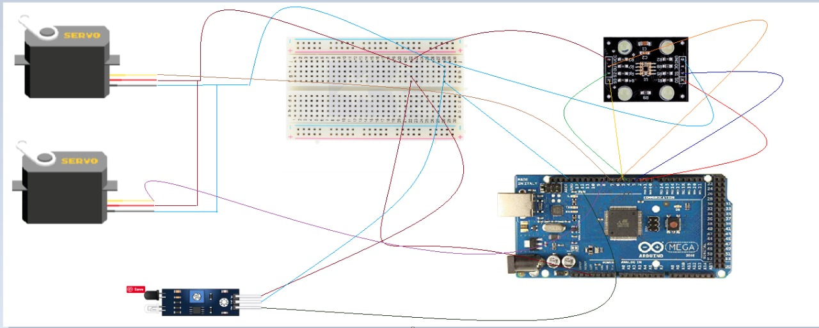
SYSTEM DIAGRAM

Slide 3
HARDWARE AND SOFTWARE REQUIREMENTS
HARDWARE REQUIREMENTS:
ARDUINO MEGA WITH USB CABLE
COLOR SENSOR(TCS3200)
IR SENSOR(LM393)
SERVO MOTORS
CONNECTING WIRES
BREAD BOARD
FIBER BOARD
SOFTWARE REQUIREMENTS:
ARDUINO IDE

Slide 4
COST OF THE PROJECT
ARDUINO MEGA WITH USB CABLE: Rs.900/-
COLOR SENSOR: Rs.300/-
IR SENSOR: Rs.90/-
SERVO MOTORS (2): Rs.250/-
CONNECTING WIRES (30): Rs.50/-
BREAD BOARD: Rs.200/-
FIBER BOARD: Rs.100/-
TOTAL COST: Rs.2140/-

Slide 5

THANK YOU !

